Slide 1
PRIVACY PRESERVING DATA MINING
SaGAR BAVER BE/10413/2012 UNDER THE GUIDANCE OF:
UjJWAL SACHDEVA BE/10305/2012 Dr. SHASHANK PUSHKAR
SURAJ KAMAL GUPTA BE/10306/2012

Slide 2
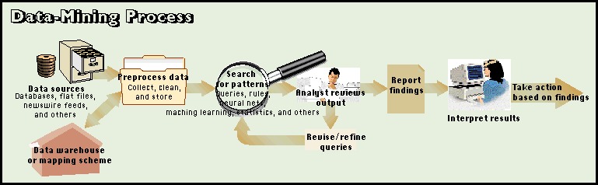
DATA MINING
Data mining is the process of analyzing data from different perspectives and summarizing it into useful information.
Technically, data mining is the process of finding correlations or patterns among dozens of fields in large relational databases.

Slide 3
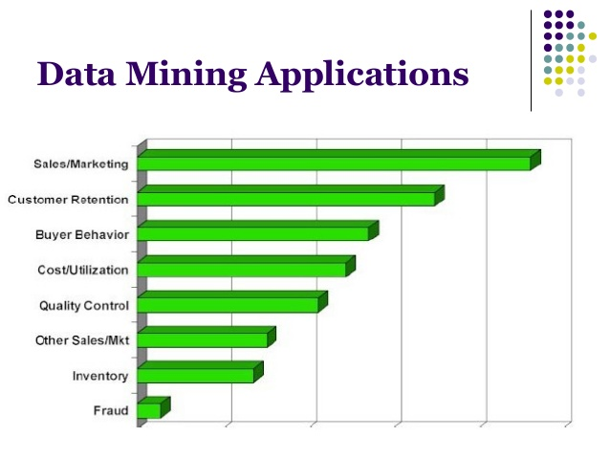
Data mining in real life scenario
Spam Filters
Advertisement
Recruiting/Attracting customers
Parts failure prediction
Credit/Risk Scoring
Fraud/Non-Compliance Anomaly detection

Slide 4
Need for Privacy Protection
The problem with data mining is that with the availability of non-sensitive information, one is able to infer sensitive information that is not to be disclosed.
Thus privacy is becoming an increasingly important issue in many data mining applications.
Data mining requires data preparation which can uncover information or patterns which may compromise confidentiality and privacy obligations.

Slide 5
Privacy Preserving Data Mining (PPDM)
PPDM is based on k-anonymity which protects subject - specific sensitive data by anonymizing it before it is released for data mining.
5 dimensions of PPDM
The distribution of the basic data.
How basic data are modified.
Which mining method is being used.
If basic data or rules are to be hidden.
Which additional methods for privacy preservation are used.

Slide 6
K-Anonymity: Intuition
Given person-specific field-structured data, produce a release of the data with scientific guarantees that the individuals who are the subjects of the data cannot be re-identified while the data remain practically useful.
The information for each person contained in the released table cannot be distinguished from at least k-1 individuals whose information also appears in the release.
Example: you try to identify a man in the released table, but the only information you have is his birth date and gender. There are k men in the table with the same birth date and gender.

Slide 7
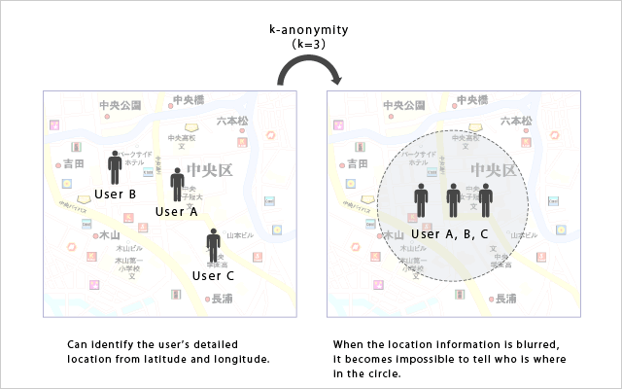

Slide 8
Quasi-Identifiers
Key attributes
Name, address, phone number - uniquely identifying!
Always removed before release
Quasi-identifiers
(5-digit ZIP code, birth date, gender) uniquely identify 87% of the population in the U.S.
Can be used for linking anonymized dataset with other datasets

Slide 9
Achieving k-Anonymity
There are two common methods for achieving k-anonymity for some value of k.
Suppression: In this method, certain values of the attributes are replaced by an asterisk '*'. All or some values of a column may be replaced by '*'.
Generalization: In this method, individual values of attributes are replaced by with a broader category.
For example, the value '19' of the attribute 'Age' may be replaced by ' ≤ 20', the value '23' by '20 < Age ≤ 30' , etc.
Timeline July 2015 to September 2015

Slide 10
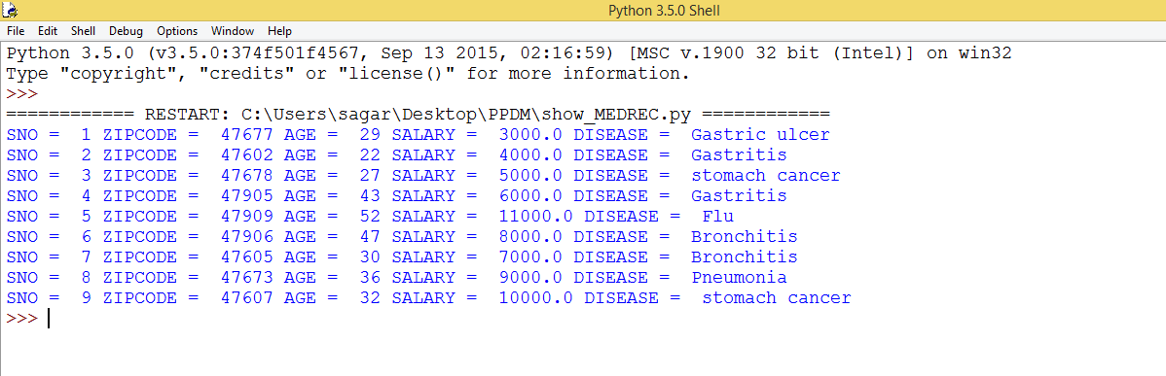
INPUT TABLE

Slide 11
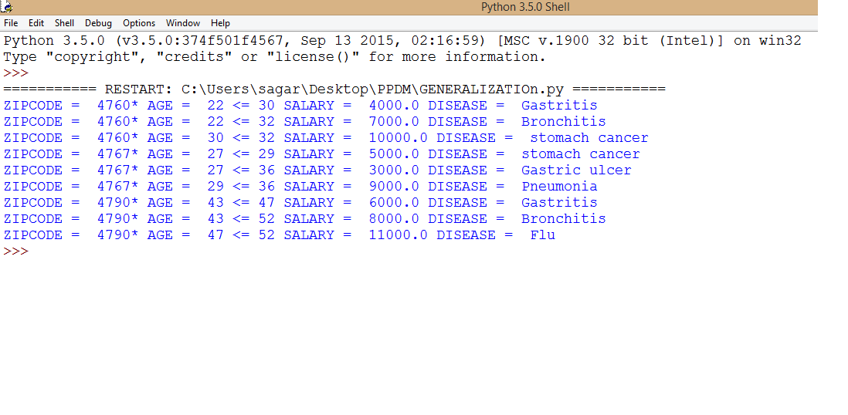
OUTPUT SNIPPET

Slide 12
FEATURE SET PARTITIONING AND SELECTION
In feature set partitioning, the goal is to decompose the original set of features into several subsets in order to create a classification model for each subset.
It generalizes the task of feature selection which is extensively used in data mining.
Feature selection provides a representative set of features from which a classifier is constructed.
In this report we implement feature set selection using first a genetic algorithm based approach followed by the popular cuckoo search.

Slide 13
Genetic Algorithm Terminologies
Individual | Any possible solution
Population | Group of all individuals
Search Space | All possible solutions to the problem
Chromosome | Blueprint for an individual
Trait | Possible aspect of an individual
Allele | Possible settings for a trait
Locus | The position of a gene on the chromosome
Genome | Collection of all chromosomes for an individual

Slide 14
Outline of the Genetic Algorithm
Randomly generate a set of possible solutions to a problem, representing each as a fixed length character string
Test each possible solution against the problem using a fitness function to evaluate each solution
Keep the best solutions, and use them to generate new possible solutions
Repeat the previous two steps until either an acceptable solution is found, or until the algorithm has iterated through a given number of cycles (generations)

Slide 15
Basic Operators of Genetic Algorithm
Reproduction: It is usually the first operator applied on population. Chromosomes are selected from the population of parents to cross over and produce offspring. It is based on Darwin’s evolution theory of “Survival of the fittest”. Therefore, this operator is also known as ‘Selection Operator’.
Cross Over: After reproduction phase, population is enriched with better individuals. It makes clones of good strings but does not create new ones. Cross over operator is applied to the mating pool with a hope that it would create better strings.
Mutation: After cross over, the strings are subjected to mutation. Mutation of a bit involves flipping it, changing 0 to 1 and vice-versa.
Timeline: October 2015 to January 2015

Slide 16
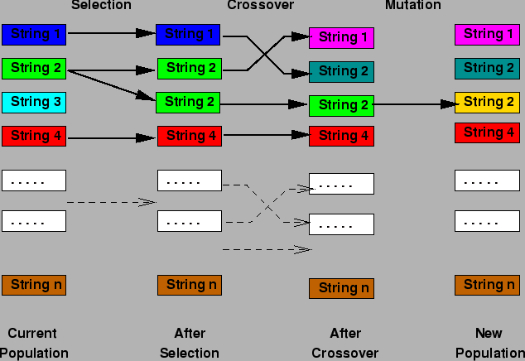

Slide 17
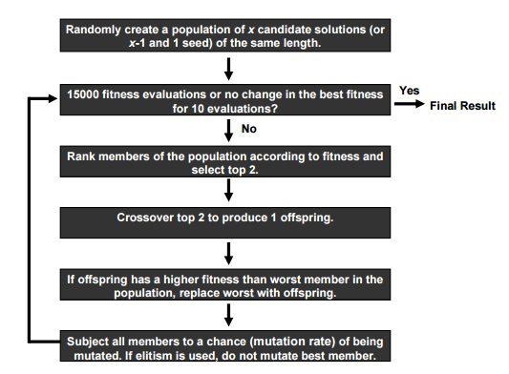

Slide 18
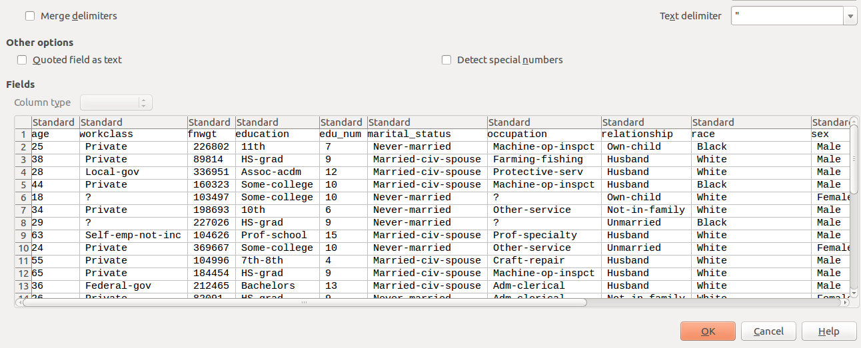
UCI Adult Repository

Slide 19
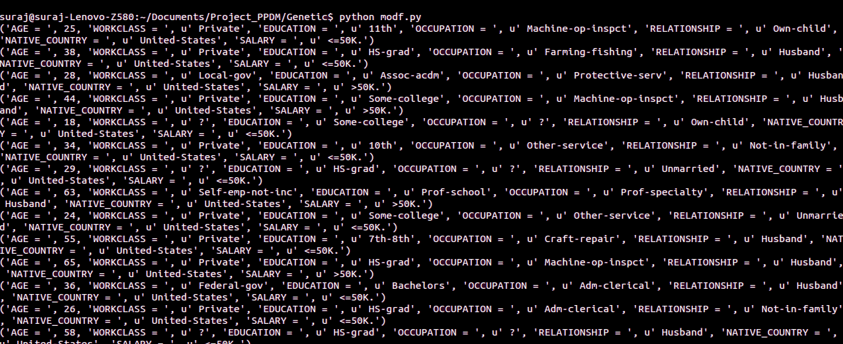
Table of Values

Slide 20
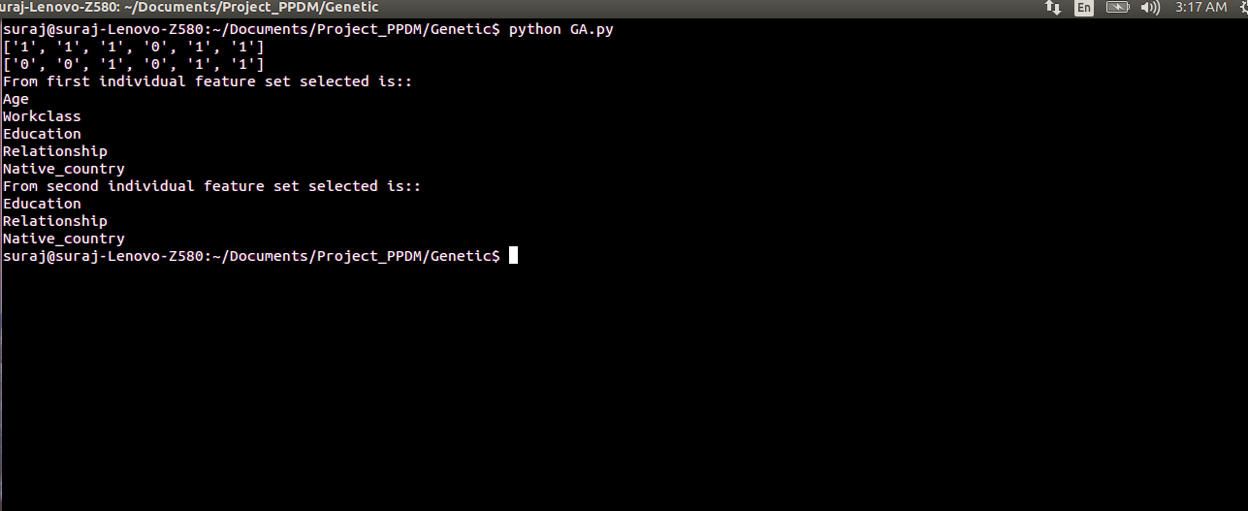
Output Snippet of GA based DMPD Implementation.

Slide 21

Cuckoo search algorithm
A method of global optimization based on the behavior of cuckoos was proposed by Yang & Deb (2009).
The original “cuckoo search (CS) algorithm” is based on the idea of the following :-
How cuckoos lay their eggs in the host nests.
How, if not detected and destroyed, the eggs are hatched to chicks by the hosts.
How a search algorithm based on such a scheme can be used to find the global optimum of a function.

Slide 22
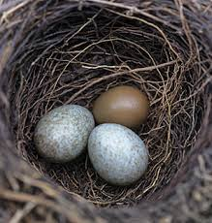
Characteristics of Cuckoo search
Each egg in a nest represents a solution, and a cuckoo egg represents a new solution.
The aim is to employ the new and potentially better solutions (cuckoos) to replace not-so-good solutions in the nests.
In the simplest form, each nest has one egg.
The algorithm can be extended to more complicated cases in which each nest has multiple eggs representing a set of solutions

Slide 23
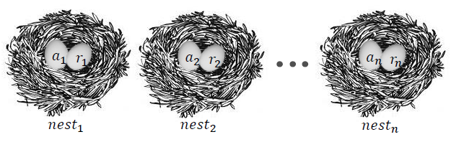
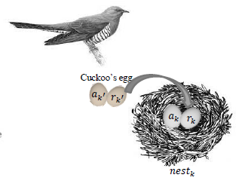
Cuckoo search Algorithm for feature set selection
Step 1: Generate initial population of n host nests.
Creating a new population using initial population (host eggs) using the technique of levy flight.

Slide 24
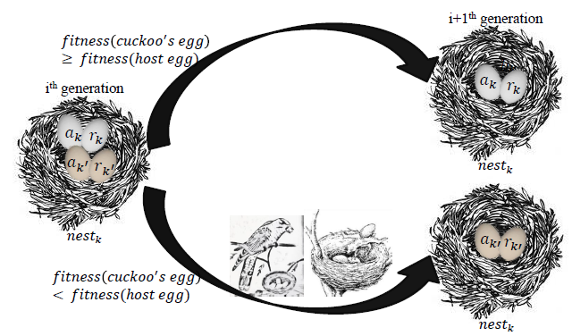
Step 3: Compare the fitness of cuckoo’s egg with the fitness of the host egg.
Step 4: If the fitness of cuckoo’s egg is better than host egg, replace the egg in nest k by cuckoo’s egg. If the fitness of the cuckoo’s egg is not better then there is a chance that the host eggs will not be selected in order to make the search more exhaustive.
Timeline: Jan 2015 to march 2015

Slide 25
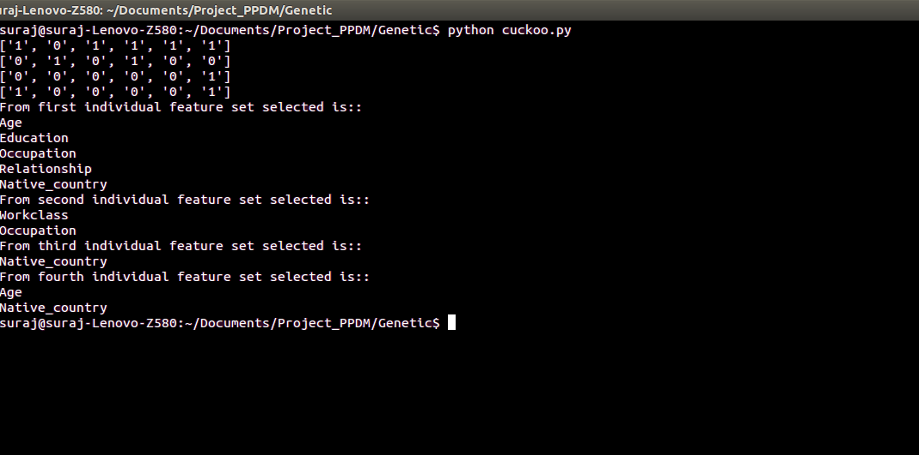
Output Snippet of CS based Implementation.

Slide 26
Comparative Study
The performance comparison of feature set partitioning and selection using both genetic algorithm (DMPD) and cuckoo search is carried out as follows.
The minimum fitness value difference between two successive iterations which forms the stopping condition was kept a constant for both the algorithms.
Both the algorithms were run on the same dataset for the same number of times (in this case 50).
The k – anonymity constraint was also kept constant for both algorithms (k = 3).
For each algorithm the number of iterations it takes to converge were recorded and plotted against the number of runs of each algorithm.

Slide 27
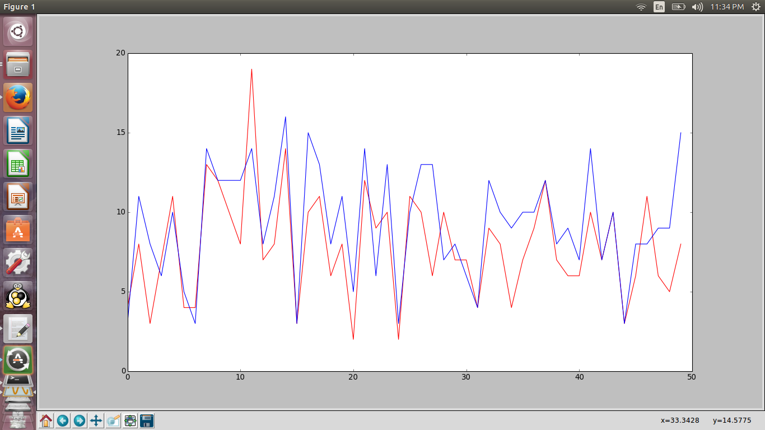
RED: CS ALGO, BLUE: GA ALGO

Slide 28
Result and Conclusions
From the graph plot it is evident that the cuckoo search algorithm generally converges faster than the genetic algorithm based search.
Given a database both the feature set selection algorithms used in this report optimally select the set of features that satisfy the k – value constraints. The cuckoo search algorithm converges to a final set of values faster than the genetic algorithm based search owing to the method of generating the next closest population.
A new data anonymization method by randomizing the data records is introduced in this project. We arbitrarily replace part of the values in each record while providing the data relationships in the entire data set, which is dissimilar from most anonymization methods. This method not only accomplishes a higher level of privacy protection, but also preserves more knowledge than the other anonymization methods. We can say that, the valuable relations which are less susceptible can be exposed more precisely than the sensitive ones.

